Slide 1

PANIMALAR ENGINEERING COLLEGE
(An Autonomous Institution)
Department of Mechanical Engineering
EMISSION AND PERFORMANCE STUDY IN HOMOGENEOUS CHARGE COMPRESSION IGNITION (HCCI) ENGINE
PRESENTED BY
S.V. RAGUL (211420114084)
B. SANTHOSH KUMAR (211420114100)
C. SRIDHAR (211420114112)
R. SANTHOSH (211420114098)
UNDER THE GUIDANCE OF
S. THAMIZH SELVAN ME.,(PhD)
Assistant Professor
Department of Mechanical Engineering

Slide 2

PANIMALAR ENGINEERING COLLEGE
Department of Mechanical Engineering
ABSTRACT:
Now a day Society have a strict regulation in emission standards to operate an engine.
So we worked for the better performance engine to get the better emission standard engines.
so far, we need a better performance and ultra low emission engines through HCCI mode of operation.
we fabricated a engine frame and other accessories to converted a diesel engine to dual fuel engine at HCCI mode of operation.
We fitted a carburetor in the diesel engine to supply the homogeneous charge in lean mixture ratio.
The ignition timing is controlled by the diesel pilot injection system.
we have got the result of ultra low emission engine, the emission from the engine is lesser than the BS-vi norms.
We tested a both diesel and petrol in a gas analyzer and we got lesser emissions in both the test.

Slide 3
PANIMALAR ENGINEERING COLLEGE
Department of Mechanical Engineering
HOMOGENEOUS CHARGE COMBUTION IGNITION ENGINE:
PRINCIPLE OF HCCI ENGINE:

Slide 4
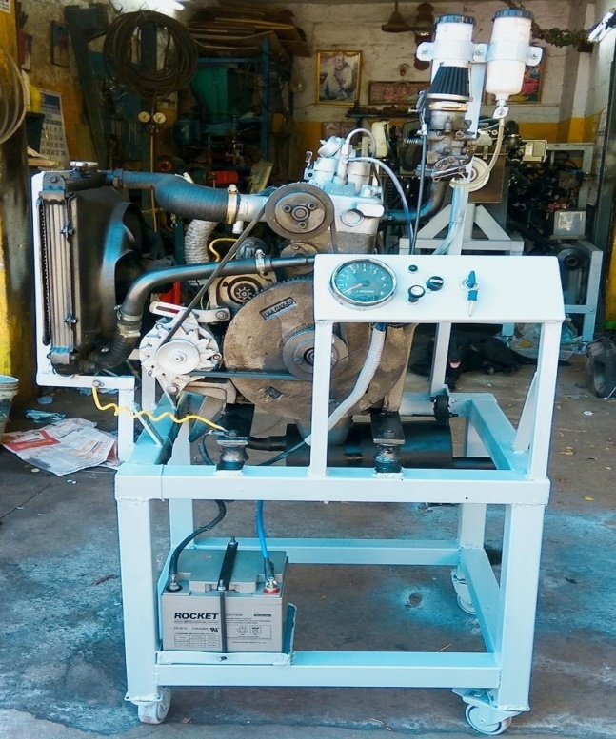
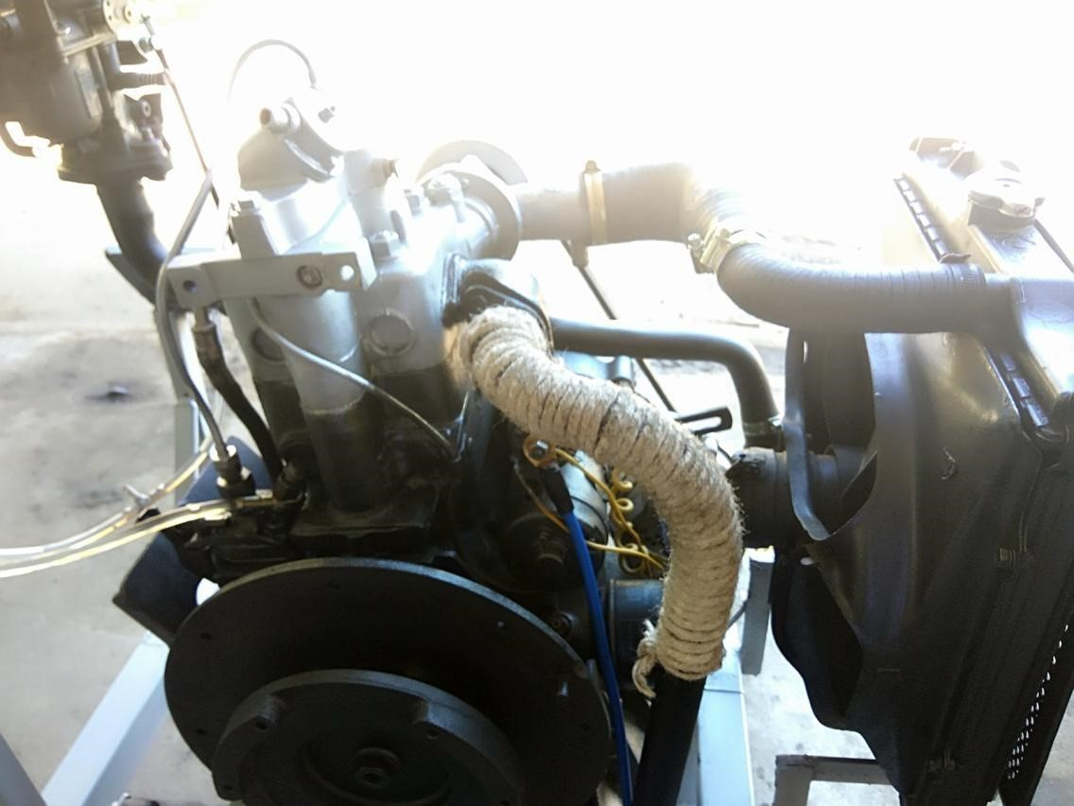
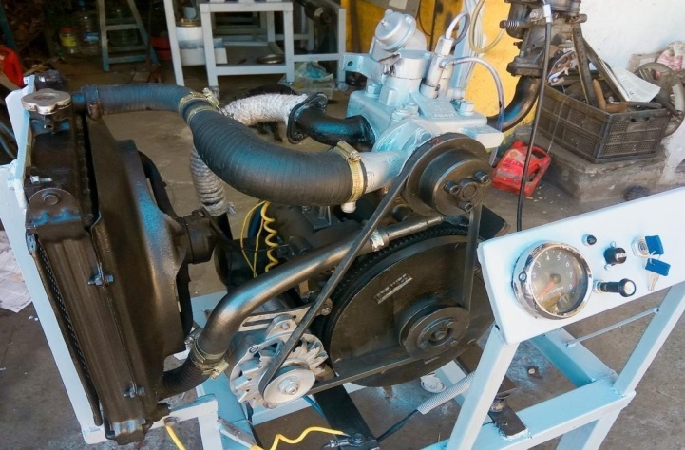
PANIMALAR ENGINEERING COLLEGE
Department of Mechanical Engineering
EXPERIMENTAL SETUP :
Photograph (front view)
Photograph (back view)
Photograph (isometric view)

Slide 5
PANIMALAR ENGINEERING COLLEGE
Department of Mechanical Engineering
CONTROLS:

Slide 6
PANIMALAR ENGINEERING COLLEGE
Department of Mechanical Engineering
ASSEMBLY OF CARBURETTOR:

Slide 7
PANIMALAR ENGINEERING COLLEGE
Department of Mechanical Engineering
MODIFICATION IN DIESEL INJECTOR:

Slide 8
PANIMALAR ENGINEERING COLLEGE
Department of Mechanical Engineering
EMISSION COMPARISONS:
Emission standards are the legal requirements governing air pollutants released into the atmosphere. Emission standards set quantitative limits on the permissible amount of specific air pollutants that may be released from specific sources over specific timeframes. They are generally designed to achieve air quality standards and to protect human life. Many emissions standards focus on regulating pollutants released by automobiles (motor cars) and other powered vehicles. Others regulate emissions from industry, power plants, small equipment such as lawn mowers and diesel generators, and other sources of air pollution.

Slide 9
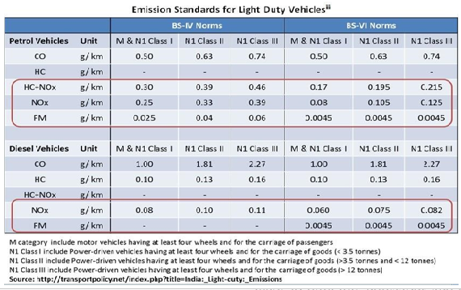
PANIMALAR ENGINEERING COLLEGE
Department of Mechanical Engineering
EMISSION COMPARISONS:

Slide 10
PANIMALAR ENGINEERING COLLEGE
Department of Mechanical Engineering
CONCLUSION:
Tested a HCCI mode of charge will vary the emission and it also leads to ultra low emissions and reduced exhaust gas temperature .
And also we learned about the auto ignition of fuel and controlled auto ignition of the engine.
We should also introduced a new method of pilot injection systems to the engine market and tested with both diesel and petrol engine gas analyzer.
It will results lesser than BS-VI norms and the engine is under control by diesel pilot injection system.
By this engine we got a ultra low emissions vehicle (ULV) and it is nearer to zero emission vehicle (ZEV).

Slide 11

PANIMALAR ENGINEERING COLLEGE
Department of Mechanical Engineering

